Slide 1
A new datatype in LabVIEW
Sets and Maps
Peter Horn – CLA/CTA
Senior Applications Engineer - NI

Slide 2
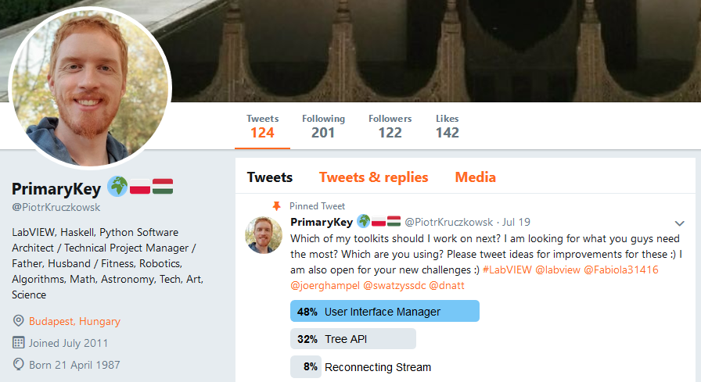
Thanks to PrimaryKey (Piotr Kruczkowsk)

Slide 3
Agenda
What are LabVIEW Sets and Maps?

Slide 4
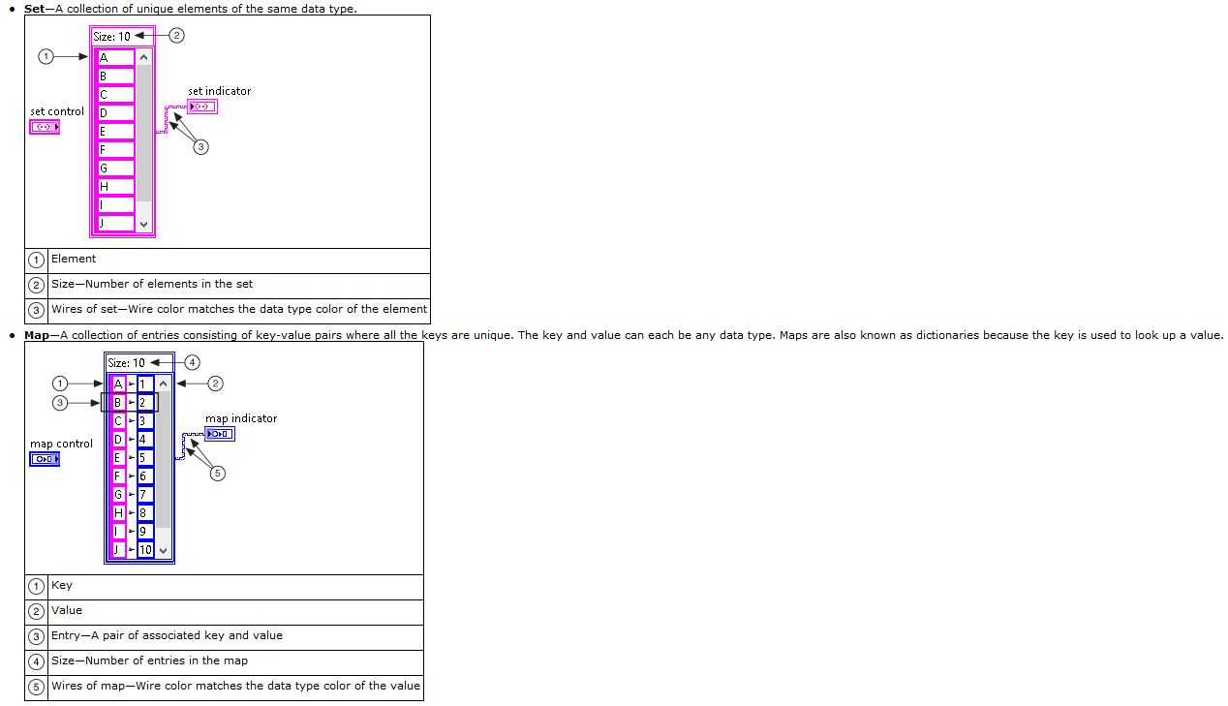
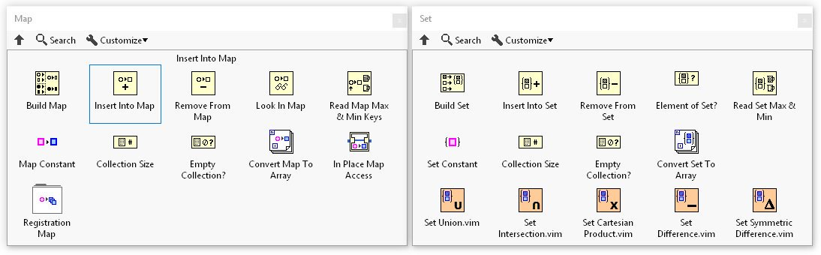
What are LabVIEW Sets and Maps?

